Slide 1
Selenium 4 New Features

Slide 2
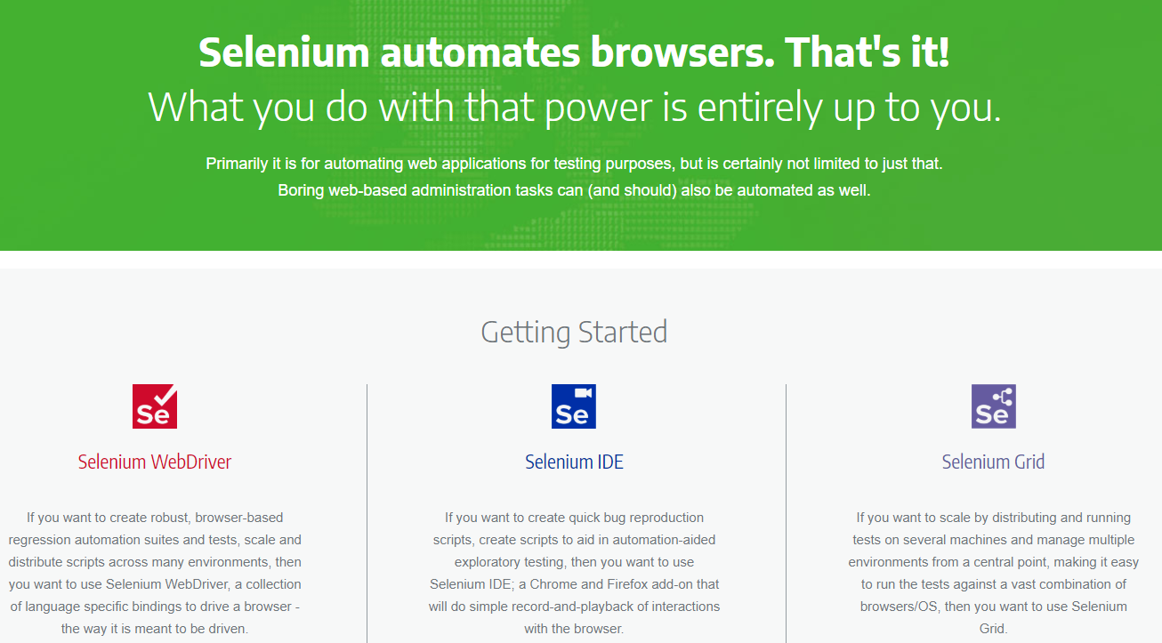
Selenium 4 Components
Selenium WebDriver
Selenium IDE
Selenium Grid

Slide 3
Selenium 4 New Features Demo
W3C WebDriver Protocol
Relative Locators
New Window/New Tab
getRect (location & size)
WebElement Screenshot
Chrome DevTools Protocol

Slide 4
Selenium
WebDriver

Slide 5
Selenium
IDE

Slide 6
Selenium IDE
Backup Element Selectors
Control Flows
Command Line Runner
Reuse A Test Case
Continuous Integration
Debugging

Slide 7
Selenium
Grid

